Slide 1
Real-time Urban Microclimate Analysis Using Internet of Things
Ganesh S
Class no.27 S7 B.Tech CSE
Dept. of CSE,MACE,Kothamangalam
12 September 2018

Slide 2
Contents
Introduction
Existing method
Challenges
Proposed method
IOT (Sensor data collection Architecture)

Slide 3
Contents (cont..)
Estimation Algorithm
Anomaly Detection
Complexity
Conclusion
References

Slide 4
Introduction
U.H.I. (Urban Heat Islands)
Modelling of Complex Ecosystem
Canopy cover, buildings, parks

Slide 5
Introduction (cont..)
Multivariate parameters
Geographic Information system
Real Time analysis

Slide 6
Existing Method
Data from meteorological stations
Offline data
No Real time processing
Lower analysis speed
Non multivariate

Slide 7
Meteorological stations
One equipment reads data for a large area
Lack of data optimization
Lack of indoor data collection

Slide 8
Challenges
Limited availability of data
Real time analysis
Identify anomalies / unusual patterns
Inclusion of multivariate data

Slide 9
Proposed method
Interactive real time geovisualization framework
Spatio-temporal estimation (Bayesian maximum entropy)
Anomaly detection using hyper ellipsoidal models
Indoor sensor deployment
Real time and historical data analysis

Slide 10
IOT (Sensor data collection Architecture)
Sensor Model
Wireless Sensor Network
Sensor Network
IOT Gateway
Cloud
Estimation algorithm
middleware

Slide 11
IOT (Sensor data collection Architecture) cont..
Sensor Network
sensor
Data fusion center &
Sensor board
sensor

Slide 12
IOT (Sensor data collection Architecture) cont..
Sensor Node / Data collection in sensors
Star topology to sensor board
Signal x with a rate of n
Wireless transmission
n
Buffer with space of p
+
x
Sampling rate n

Slide 13
IOT (Sensor data collection Architecture) cont..
Sensor Board
Micro-controller like arduino
Sends to associated gateway
Embedded data fusion center
Use fuzzy logic to ensure event drive data collection
Lacks processing power

Slide 14
IOT (Sensor data collection Architecture) cont..
IOT Gateway
Receives data through low energy communication links like ZigBee
Edge Device
Data processing and management cost
Convert heterogeneous data to standard form
Data collection Controller

Slide 15
IOT (Sensor data collection Architecture) cont..
Control monitoring system
Specification of security mechanism
Power monitoring
Data is send to database or to cloud storage

Slide 16
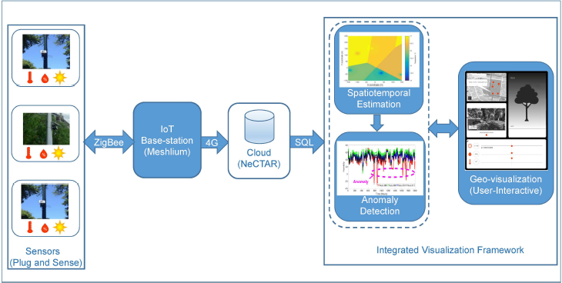
Courtesy Real-time Urban Microclimate Analysis Using Internet of Things , IEEE Journal 2018

Slide 17
Estimation Algorithm
For any location take it as point p
Each p is represented as p(s,t)
s-sensor node , t-time
S=[s1,s2…..sn] we have X=[x1,x2…xn] where X is sensor data of s1, Xmap=[X1,X2,…Xn]
BME optimisation

Slide 18
Estimation Algorithm (cont..)
3 stages in BME(Bayesian maximum entropy)
Prior stage
General knowledge collection
Basic principles and information
Shannon's information

Slide 19
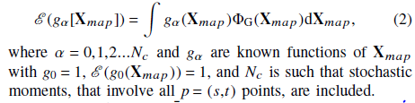
Estimation Algorithm (cont..)

Slide 20
Estimation Algorithm (cont..)
Pre-posterior stage
Calculate the specific knowledge
Includes hard and soft data
Performs estimation operation

Slide 21
Estimation Algorithm (cont..)
Posterior Stage
optimisation operation

Slide 22
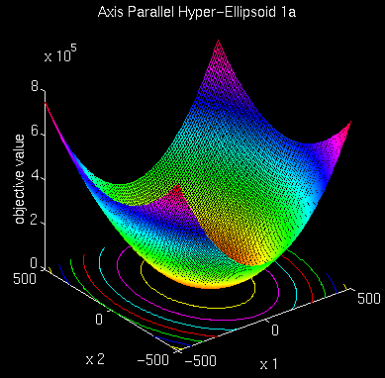
Anomaly Detection
Obtained data can be represented in form of hyper ellipsoids
Courtesy: www.google.com/hyperellipsoid

Slide 23
Anomaly Detection
One ellipse is selected as parent and its following ellipsoid as child
Distance between an ellipsoid and its child ellipsoid is calculated
This value is used to identify the anomaly

Slide 24

Anomaly Detection (cont..)
Neighbour Reachability Density
Ellipsoidal Neighbourhood Outlier Factor

Slide 25
Anomaly Detection (cont..)
distance between two ellipsoid < ENOF
No anomaly
distance between two ellipsoid >= ENOF
Presence of anomaly

Slide 26
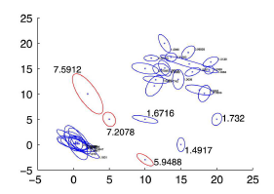
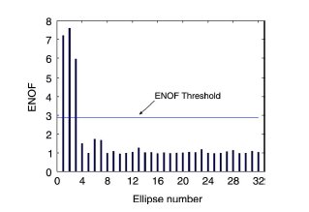
Anomaly Detection (cont..)
Courtesy Real-time Urban Microclimate Analysis Using Internet of Things , IEEE Journal 2018

Slide 27
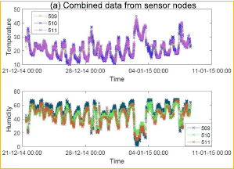
Anomaly Detection (cont..)
Courtesy Real-time Urban Microclimate Analysis Using Internet of Things , IEEE Journal 2018

Slide 28
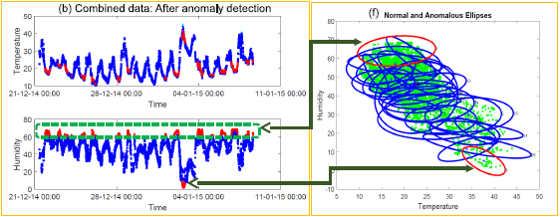
Anomaly Detection (cont..)
Courtesy Real-time Urban Microclimate Analysis Using Internet of Things , IEEE Journal 2018

Slide 29
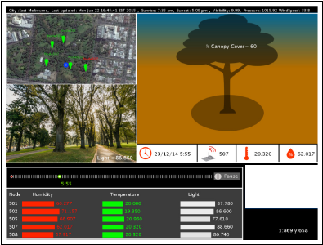
Anomaly Detection (cont..)
Helps in deciding canopy cover by analysing anomalous data
Canopy cover is referred to the data set, for each data set we have respective canopy cover
Courtesy Real-time Urban Microclimate Analysis Using Internet of Things , IEEE Journal 2018

Slide 30
Complexity
O(n3) – BME prior stage
O(2^k (k-1)!) k=no of soft sensors
O(n3) – anomaly detection

Slide 31
Conclusion
IoT sensors performs data collection (hard & soft ), (indoor & outdoor)
This data is optimised using BME
Bayesian Maximum Entropy is one of the efficient algorithm for optimisation
Hyper ellipsoidal model for anomaly detection

Slide 32
Conclusion (cont..)
Canopy cover determination
Multivariate
Highly efficient and fast

Slide 33
References
S. Rajasegarar, A. Gluhak, M. A. Imran, M. Nati, M. Moshtaghi,C. Leckie, and M. Palaniswami, “Ellipsoidal neighbourhood outlier factor for distributed anomaly detection in resource constrained networks,”Pattern Recognition, vol. 47, no. 9, pp. 2867–2879, 2014.
K. Hab, A. Middel, B. Ruddell, and H. Hagen, “Travis - a visualization framework for mobile transect data sets in an urban microclimate context,” in IEEE Pacific Visual. Symposium), April 2015, pp. 167–174.

Slide 34
Thank You

